Slide 1

Password Generation
Rui Lima 94073

Slide 2
Introduction
What is password manager.
Solution
Demonstration
Conclusions
Notes:
During this presentation I will explain what a password manager is, and talk about its advantages and disadvantages. I will present my solution to a password manager and make a small demonstration of how it works, and the conclusions I reached with this work.

Slide 3
Password Managers
Stores the user passwords.
Generates new passwords.
Automatically fills the passwords to the respective applications.
Notes:
Password managers are application, either web or desktop application, that are responsible for a users passwords. Password managers store multiple passwords of the user, are able to generate new passwords with a given specification and some are even able to automatically fill the passwords in the respective application.

Slide 4
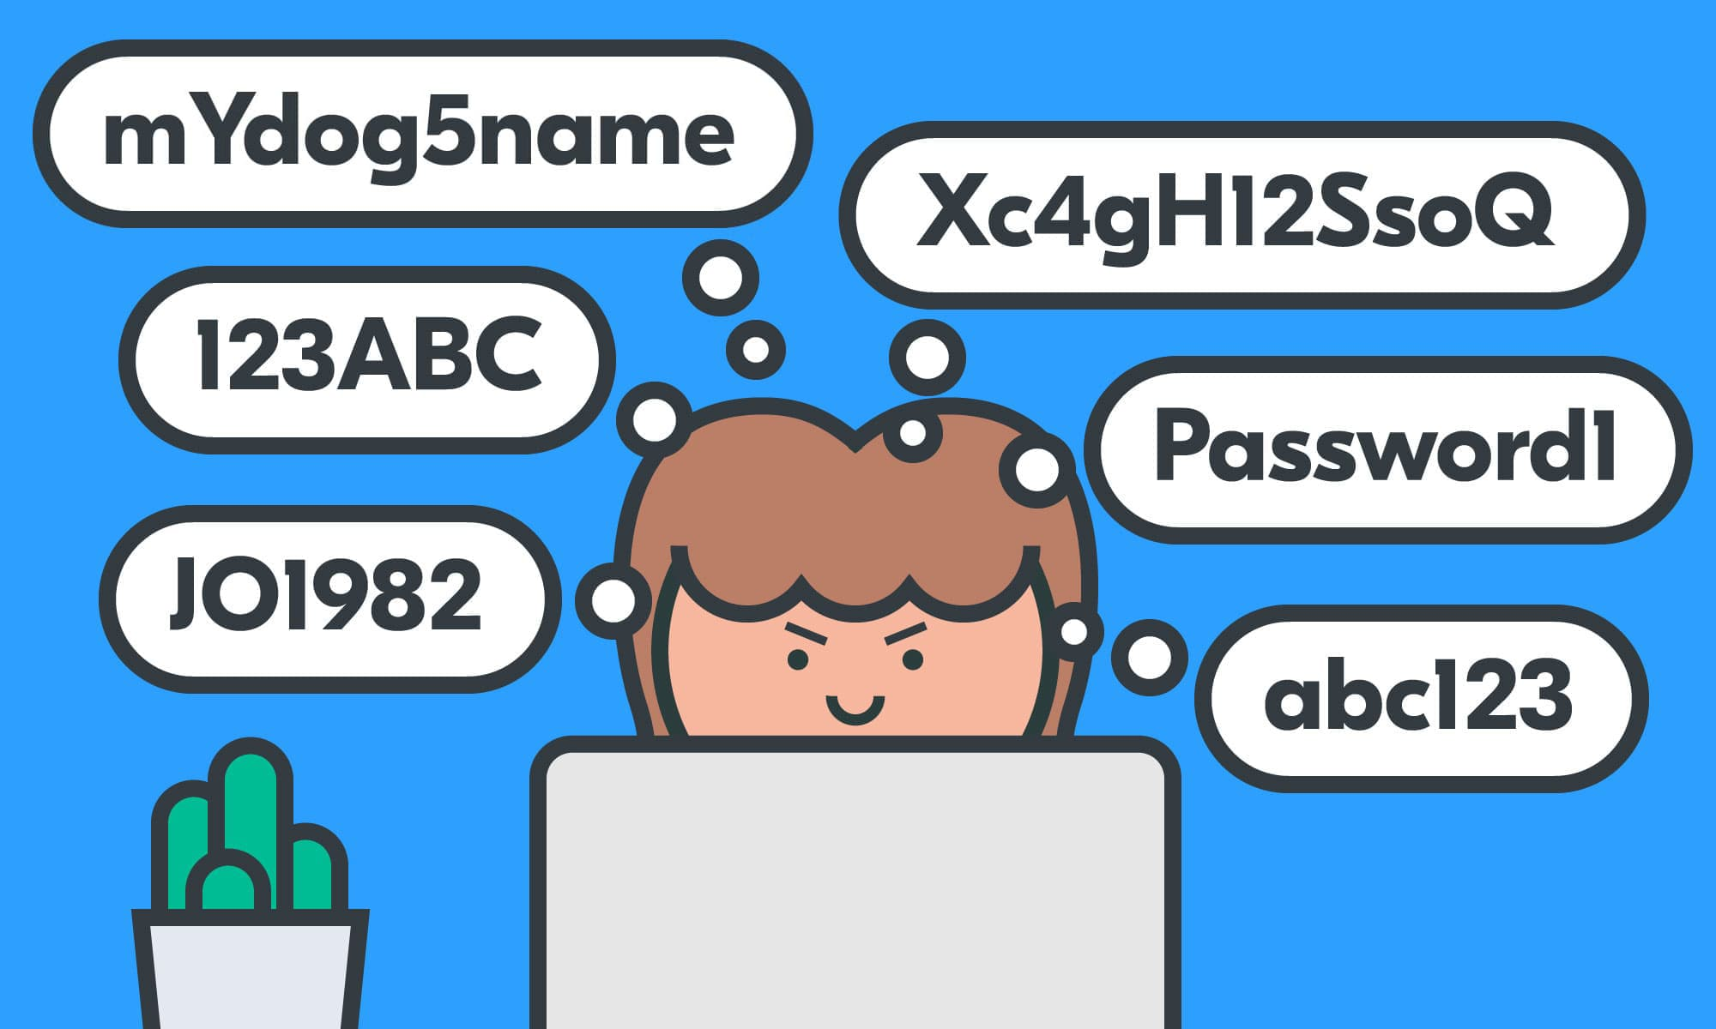
Advantages
No need to memorize all the passwords.
Password generated automatically following specific rules.
Notes:
But why should we use a password manager? Now a days we use multiple application and websites that require a login session to use and it’s extremely hard or even impossible for someone to memorize all their password, especially since a good password should be long and as random as possible. With multiple lowercases, uppercases, digits and symbols all mixed together. And with a password manager not only do we not need to remember all those password but we don’t even need to come up with them, since a password manager can generate the password for you.

Slide 5
Disadvantages
Passwords are available in a database.
Does the password really follow the predefined rules?
Vulnerable to multiple attacks, e.g, side-channel attack, cross-site request forgery, man-in-the-middle attack, etc.
Notes:
However, as everything password managers have their disadvantages. The password need to be stored somewhere, most likely a database which can be accessed by an hacker, and if the database is not protected and/or the password are stored as plain text anyone can have access to them. Since the password manager creates the password, stores it and even automatically fill it when needed how can we be sure that the password follows the rules it is supposed to, how to we know that a password is not simply the same character repeated several times. Besides that, since the password manager will fill the inbox where the password is needed, it can be vulnerable to a multitude of attacks. Either a side-channel attack, cross-site request forgery, man-in-the-middle or others.

Slide 6
Objectives
Develop an application in Gallina that generates random passwords.
Prove properties about the password generated.
Notes:
With that in mind the goal of my mini-project was to focus in the generation of a password and how to prove that it follows the rules its supposed. For that I started by developing an application written in Gallina that will generate random strings and then prove certain properties about the algorithm used.

Slide 7
Problems
Gallina does not support the execution of random programs.
Gallina function must provide the same output to the same input.
Solution:
Extract the Gallina code to Ocaml.
Ocaml allows random functions.
Notes:
During the development of this mini-project I run into multiple problems. The most important one was the Gallina does not support the execution of random programs. Since it is a language used to prove properties, it need to output the same result to the same input. And that goes against what was needed for this project. To solve, this problem the program that will run is not written in Gallina but in Ocaml. For that, I wrote code in Gallina that will be extracted to Ocaml so that it can be executed since in Ocaml there are random functions, or functions that return different output to the same input.

Slide 8
Solution
Taking as inspiration the QuickChick.
Program produces random password with given properties.
User provides as input:
Length of the password;
Number of lowercases;
Number of uppercases;
Number of digits;
Number of symbols.
Notes:
This project was not all created from scratch. I took inspiration in the project QuickChick that is a project written in Coq that is extracted to Ocaml. The finish program will take as input a set of number that indicate properties about the password such as its length, the number of lowercases, the number of uppercases, the number of digits and the number of symbols.

Slide 9
Solution
Generates each part of the password and merges them together.
Exports code to Ocaml file.
Manipulation of the Ocaml code.
Notes:
My solution is simply a proof-of-work and cannot be taken as full product ready to be used. In the current implementation, the program in generate the lowercases elements of the password, followed by the uppercases, then the digits and finally the symbols. As you can seen this is a problem since the password is not really random since it follows a pattern but again this is a proof-of-work. The program written for Coq will be extracted to Ocaml so that it can be executed. But before that, the extracted code needs to be changed so that it is ready to execute.

Slide 10


Demonstration
Notes:
Now I will make a short demonstration of the program.

Slide 11
Additional Work
Prove multiple properties about the Gallina code.
Improve the password generation algorithm.
Make less modifications in the Ocaml code.
Notes:
As you could see this project is not a complete and there is still work left to be done. The work left to be done, including proving properties about the code, and improve the algorithm for password generation since it’s not completely random. And improve the Gallina code so that there are less modification to be done in the Ocaml code.

Slide 12
Conclusions
Password managers have many advantages but also some problems.
It’s not easy solving those problems.
There are multiple challenges when proving properties about password generation algorithms.
Notes:
I hope I could show you that the password managers can’t be thought of as a perfect solution since they have some disadvantages. I hope I could show you that the existing password managers have this problem not because their developers are lazy or don’t care, but because they are hard problems to solve.

Slide 13

Questions?

